Slide 1

Procedure 01 – ROBOTC Setup & Debug
ROBOTC Setup
Inputs/Outputs
for ObstacleRacer
Cortex Debug
Lafayette Jefferson High School – Intro to Communications – Mr. White

Slide 2

ROBOTC Setup
Start the “ROBOTC for VEX Robotics 4.X” software.
Connect the Racer to the computer using the USB A-A cable.
Set up the motors and sensors.
Open the PLTW ROBOTC template:
Click File > Open Sample Program > PLTW
This is a folder typically with path C:\Program Files (x86)\Robomatter Inc\ROBOTC Development Environment 4.X\Sample Programs\VEX2\PLTW).
Open the file PLTWtemplate.
Lafayette Jefferson High School – Intro to Communications – Mr. White

Slide 3
ROBOTC Setup Cont’d.
Set up the motors and sensors.
Set platform and communications method:
Click View > Preferences > Detailed Preferences.
In the Platform tab, click the drop down under Platform Type, choose “VEX 2.0 Cortex”. Natural Language options will appear automatically.
Under Communications Port, it should read “Automatic Selection”
Click OK.
Ensure Natural Language is selected.
Click Robot > Platform Type > Natural Language PLTW
Click File, Save As, and save to your team’s OneDrive Folder under the naming convention, “ObstacleRacer_Team#”.
Complete the Project Title, Team Members, Date, and Section. Leave Task Description and Pseudocode blank for now.
Lafayette Jefferson High School – Intro to Communications – Mr. White

Slide 4
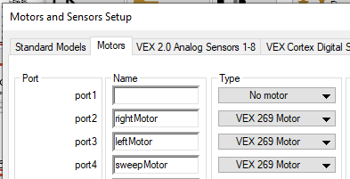
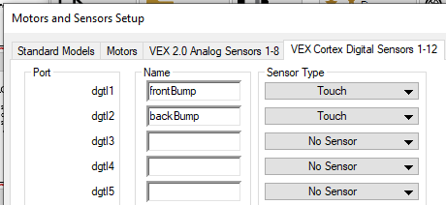
ROBOTC Setup Cont’d.
3. Set up the motors and sensors.
Click Robot.
Click Motors and Sensors Set up.
Add the motors and sensors as shown below.
Motor Setup
Sensor Setup
4. Get sign-off from the teacher before moving on.
Lafayette Jefferson High School – Intro to Communications – Mr. White

Slide 5
ROBOTC Debug
Power on the Cortex.
View motor and sensor debugger windows.
Click Robot.
Click Compile and Download Program. Leave the Debug window open.
Click Robot, Debug Windows, then Motors.
If there is not a Sensor and Motors tab available at the bottom of the window, add them through the next steps. Click Robot, Debug Windows, then Sensors.
Increase the debugger window area at the bottom to view the motor and sensor values as shown below. Note that this window can be viewed any time by clicking Robot then Debugger.
Lafayette Jefferson High School – Intro to Communications – Mr. White

Slide 6
ROBOTC Debug Cont’d.
Verify motor outputs.
Click the Motors tab at the bottom on the window.
Change the motor value(s).
Click Port 2 under the Power column.
Enter several values ranging from -127 to 127, then press Enter on the keyboard or click away from the value entry window.
Record your observations in your engineering notebook, including the threshold power setting for the motor to turn.
Lafayette Jefferson High School – Intro to Communications – Mr. White

Slide 7
ROBOTC Debug Cont’d.
Verify digital sensor inputs.
Observe the bumper switch sensor.
View the value shown beside the bumpSwitch (dgtl,2) label.
Change the bumper switch environment and observe the effect on the bumpSwitch value. Your finger can be used to activate the bumper switch.
Record your observations in your engineering notebook.
Get sign-off from the teacher before moving on.
Lafayette Jefferson High School – Intro to Communications – Mr. White

